Slide 1

NETFLIX DATA ANALYSIS
SUPARNA KARMAKAR
AICTE Internship ID-INTERNSHIP_17546440516895be537820f
Apply ID: APPLY_175666381968b4900be86ed

Slide 2

PROBLEM STATEMENT
Netflix has become one of the most prominent global streaming platforms, continuously expanding its library with a mix of original productions and licensed content. However, with growing competition from platforms like Amazon Prime, Disney+, and regional OTT providers, Netflix must strategically analyze its content catalog to identify strengths, gaps, and opportunities.
The specific problem to be addressed in this project is 'Content Trends Analysis for Strategic Recommendations'. The aim is to uncover how Netflix’s content distribution (Movies vs. TV Shows, genres, and country contributions) has evolved over the years. This will enable the identification of key genres, audience preferences, and strategic insights into global content expansion.

Slide 3
Project Description
This project analyzes the Netflix dataset to understand the trends in Movies and TV Shows. It studies how Netflix’s content has grown over the years and which genres are most popular. The project also explores which countries contribute the most to Netflix’s catalog. It helps identify what type of content Netflix focuses on and where improvements can be made. The goal is to give clear insights for better content planning and audience targeting.

Slide 4

WHO ARE THE END USERS?
The end users of this Netflix Dataset Analysis project are:
Netflix content strategy team – to plan what type of shows or movies to produce or acquire.
Data analysts and business decision-makers – to understand viewing trends and audience preferences.
Marketing teams – to target promotions based on popular genres or countries.
Researchers and students – to study OTT platform growth and content diversity.
Investors and stakeholders – to evaluate Netflix’s global expansion and performance trends.

Slide 5

Technology Used
Python - Core programming language
Pandas & NumPy - Data cleaning and preprocessing
Scikit-learn - Machine learning (model training, regression, evaluation)
Matplotlib/Seaborn- Data visualization and feature importance
Jupyter Notebook- Web based integrated development environment for running the project
File handling libraries - openpyxi (for Excel) and built-in CSV handling

Slide 6
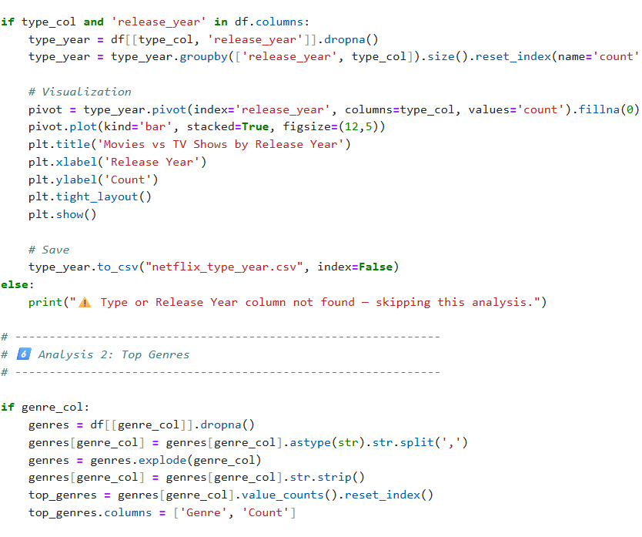
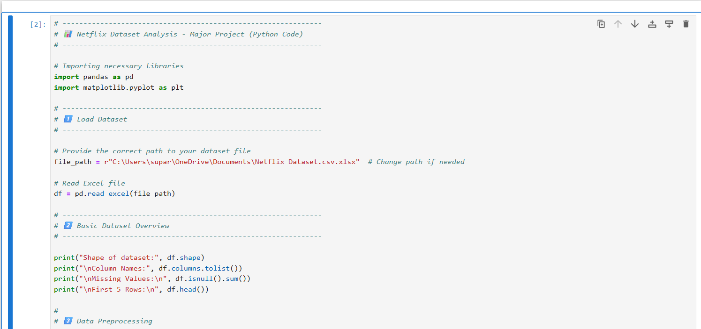
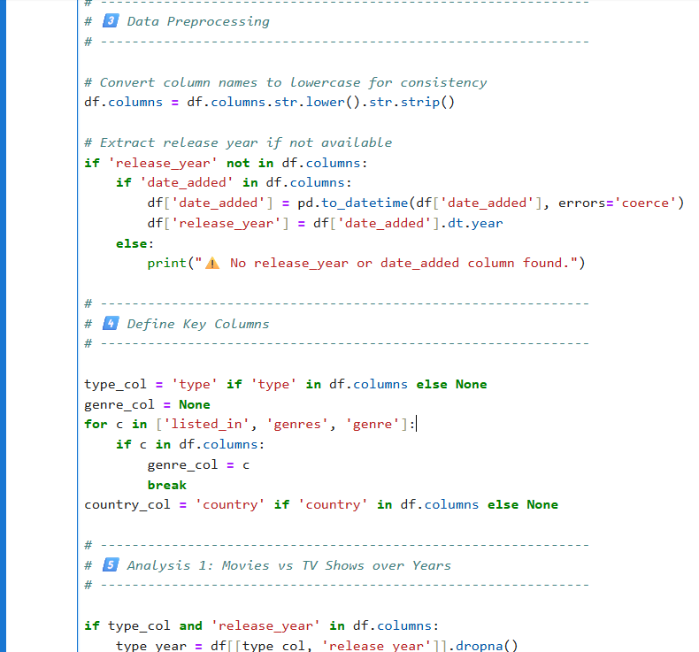
RESULTS1

Slide 7
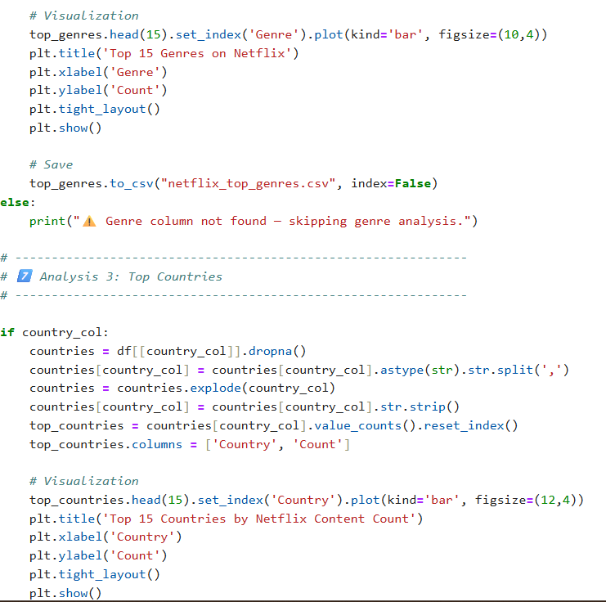
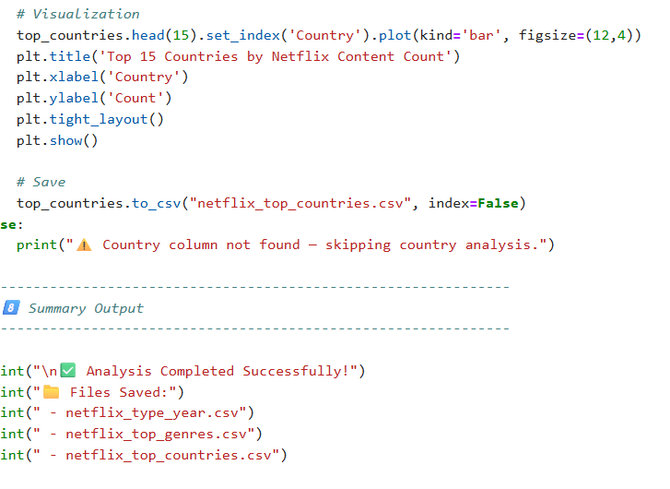
RESULTS2

Slide 8
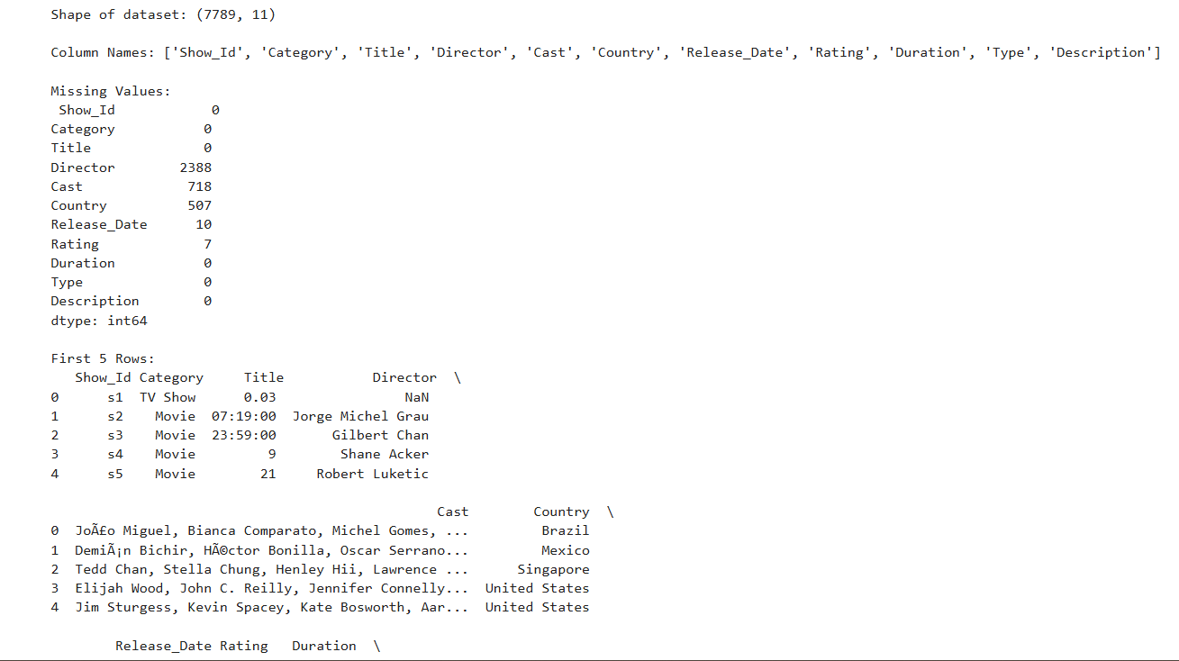
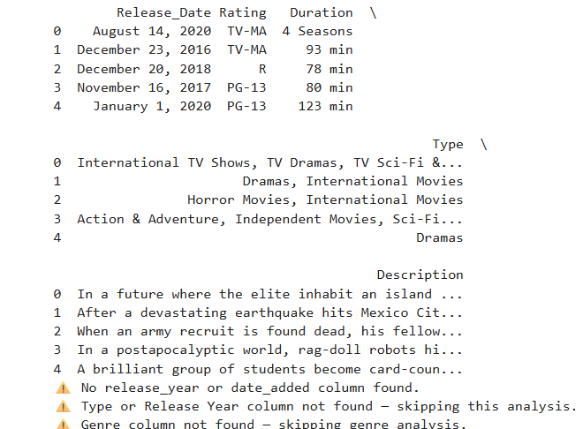
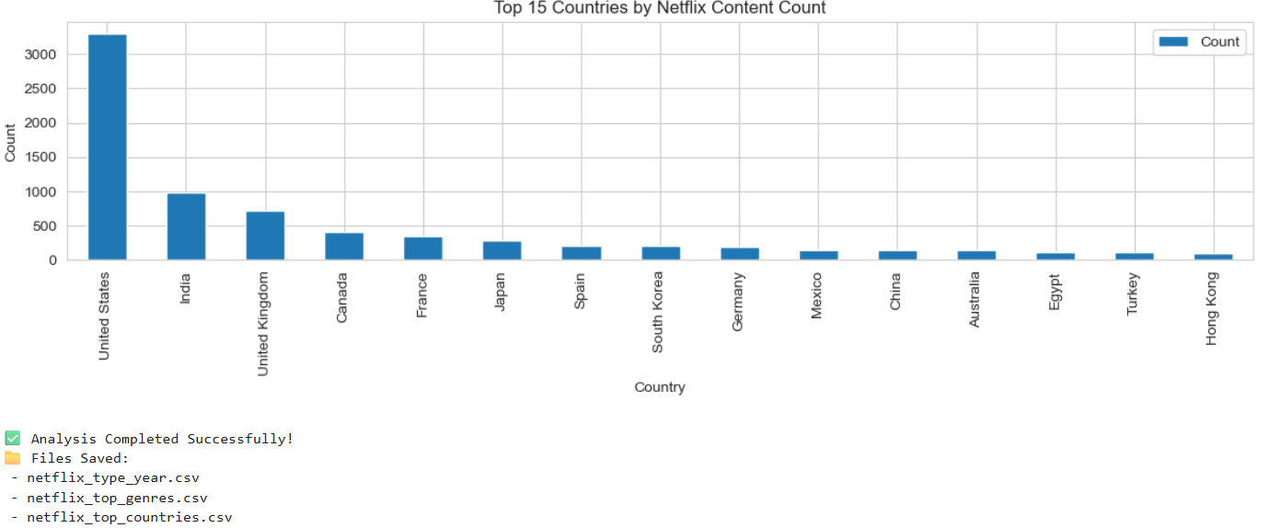
RESULTS3

Slide 9
GitHub repository
https://github.com/suparnakarmakar004/VOIS_AICTE_OCT2025_NETFLIX-DATA-ANALYSIS_SUPARNA-KARMAKAR

Slide 10

Getting started with Basics of Python Certificate

Slide 11
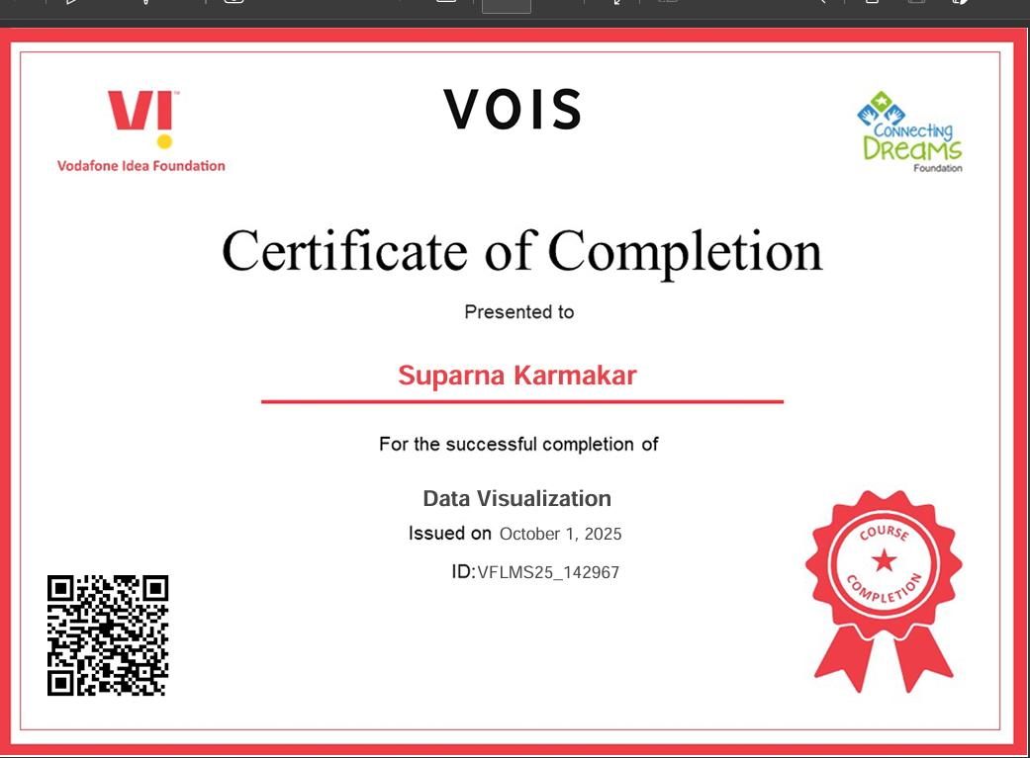
Data Visualization Certificate

Slide 12
Thank you
.
.

